Slide 1
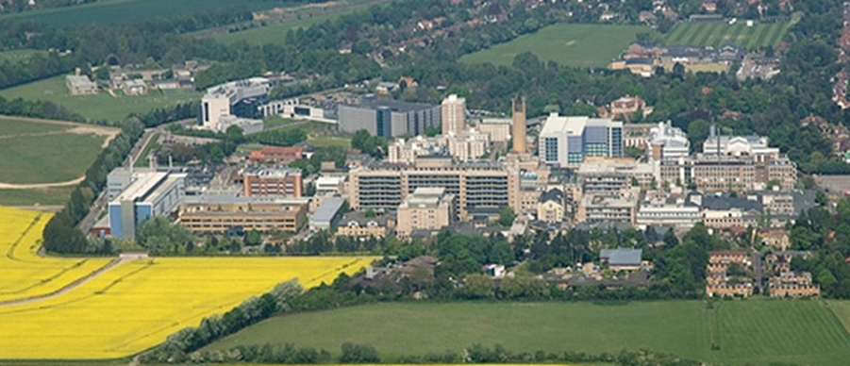

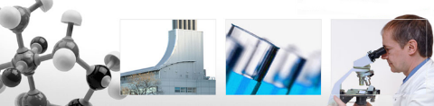
Radial Head
Fix/Replace/ Excise
Mr Lee Van Rensburg
Cambridge University Hospitals NHS trust
2020
www.cambridgeses.co.uk

Slide 2
Disclaimer
Acumed
  Paid consultancy work
  Not on radial head

Slide 3
Radial head
Classification
Mason Classification (1954)
Hotchkiss adaption (1997)
Mason – Mayo (2008)

Slide 4
Radial head
Classification
Mason Classification (1954)
3 types
    1. Undisplaced fracture (<2mm)
    2. Marginal or rim fracture, displaced
    3. Multifragmentary fracture involving whole head

Slide 5
Radial head
Classification
Hotchkiss (1997)
Adaption of Mason
    1. Undisplaced or minimally displaced (<2mm)
    2. Displaced but amenable to internal fixation
    3. Fracture not amenable to internal fixation

Slide 6

Radial head
Classification
Mason – Mayo (2008)
Adaption of Mason
    Includes suffix to denote associated
      Articular injury
        c = coronoid
        o = olecranon
      Ligamentous injury
        l = lateral collateral ligament
        m = medial collateral ligament
        d = distal radioulnar joint
van Riet RP, Morrey BF.; Clin Orth Relat Res. 2008 Jan;466(1):130-4.

Slide 7
Degrees of badness

Slide 8
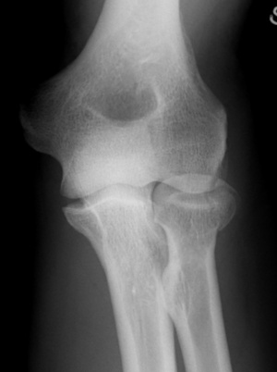
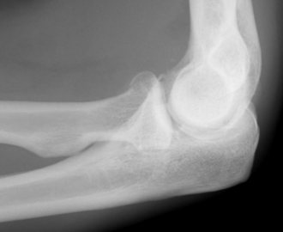
32 YO Fall

Slide 9


Insufficient evidence
Low quality evidence n=28
  Less pain 3 weeks
No difference ROM 6 weeks
No significant long term difference
Cochrane Database Syst Rev. 2014 Nov 22

Slide 10
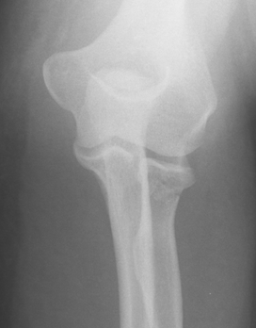
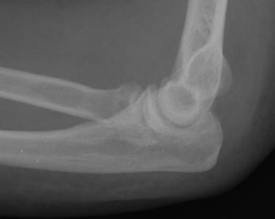
32 YO fall

Slide 11
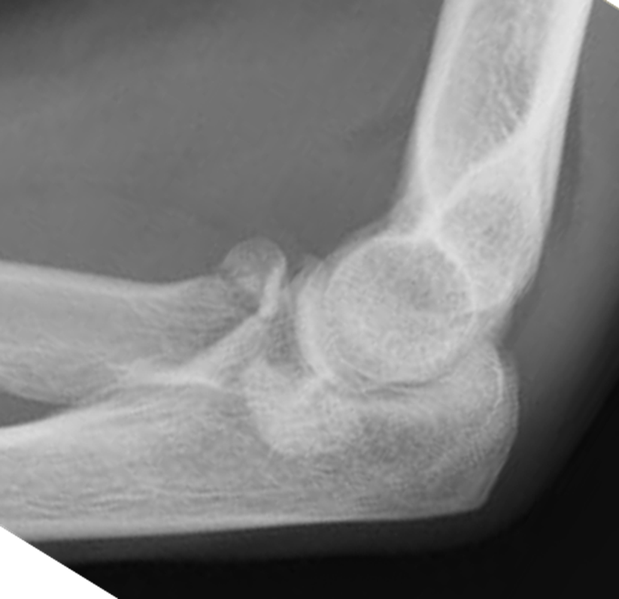

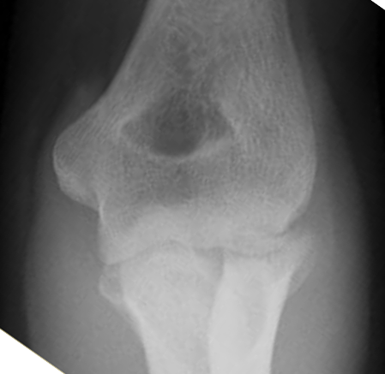


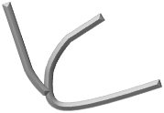
21 YO F

Slide 12


Low quality evidence
Radial head replacement
  Slightly better
  Short term (2 years)
Cochrane Database Syst Rev. 2013 May 31;(5

Slide 13

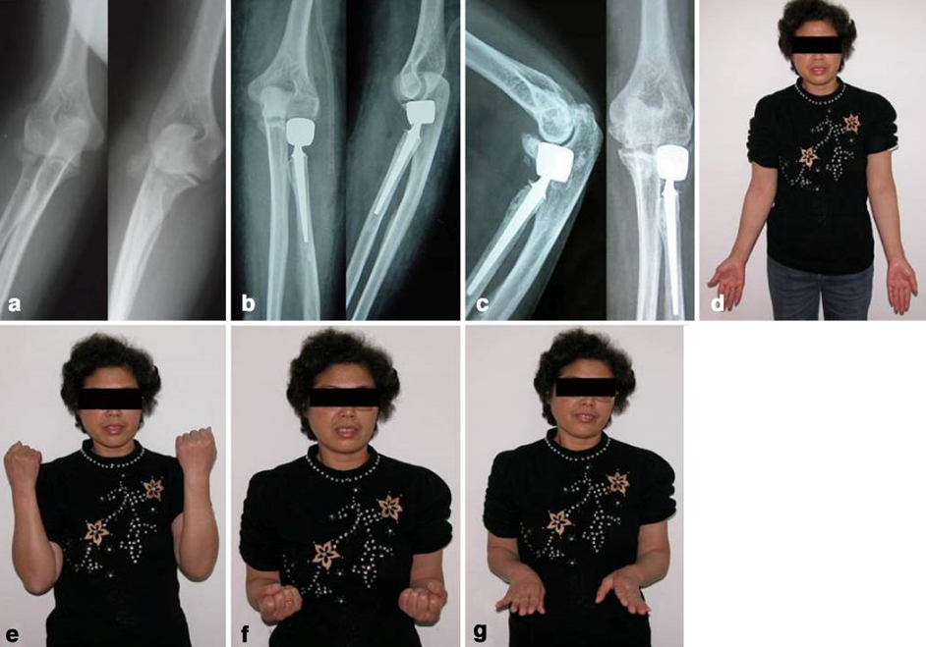
Poor studies
ORIF K wires and cannulated screws
  Cast 4 weeks
n = small
F/U 15 months
Radial head better
Int Orthop. 2009 Feb; 33(1): 249–253.

Slide 14
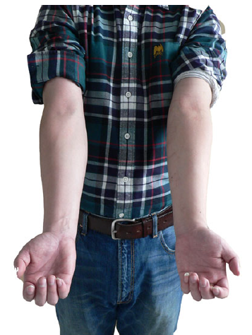
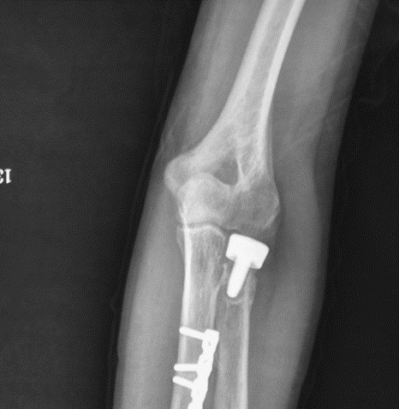
Similar
n = small
Plate and k wires
24 months
Loose head
Broberg Morrey 95
Normal elbow
Excellent function
Int Orthop. 2011 Jul; 35(7): 1071–1076.

Slide 15
Database 2007 – 2011
58404 Radial head fractures
2981 Operative treatment (5 %)
Fix 57%
Replace 38%
Excision 5%
J Hand Surg Am. 2018 Mar;43(3):241-247

Slide 16
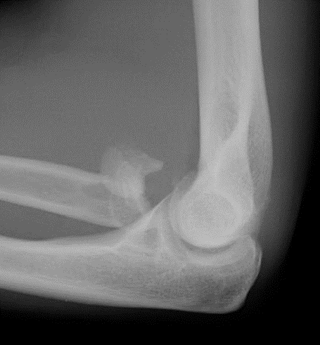

50 YO

Slide 17
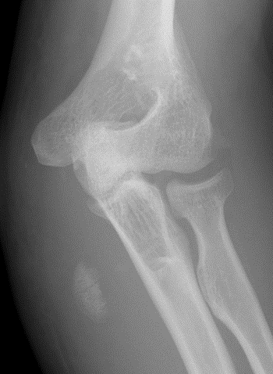
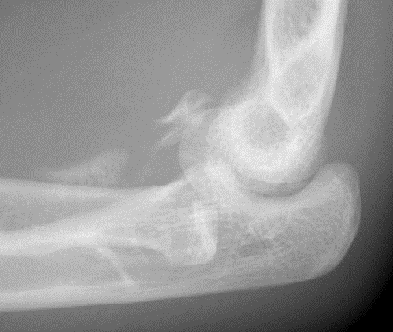
35 YO Male

Slide 18
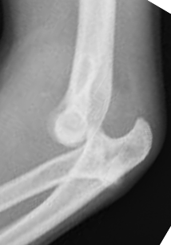
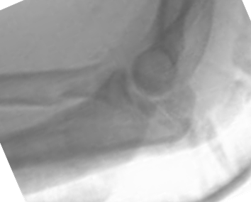
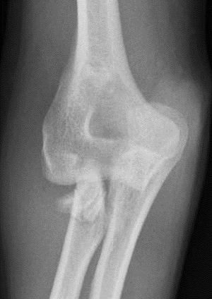
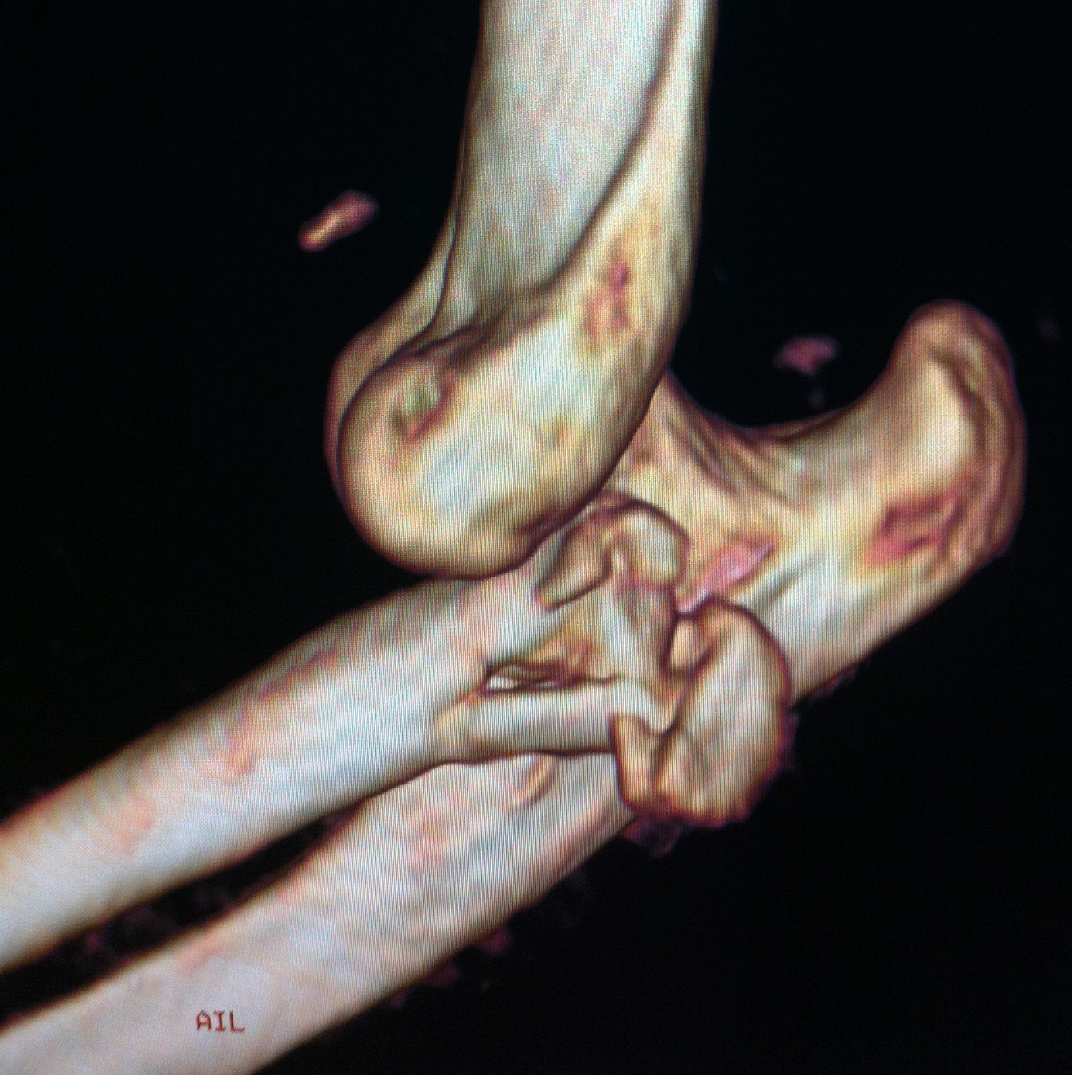
25 YO
Farmer

Slide 19

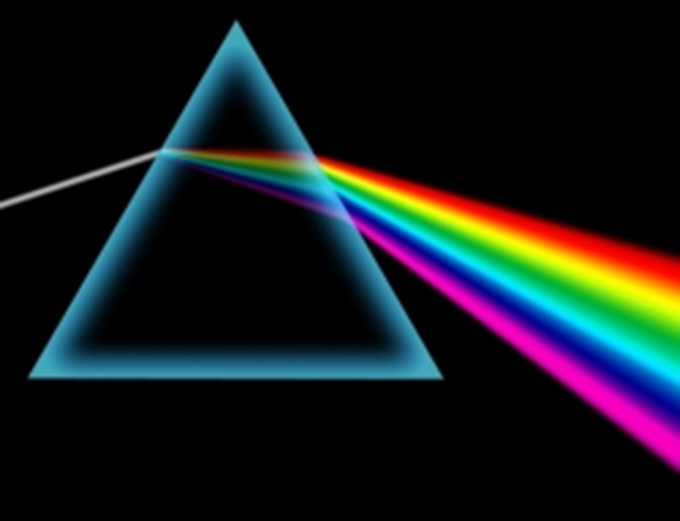
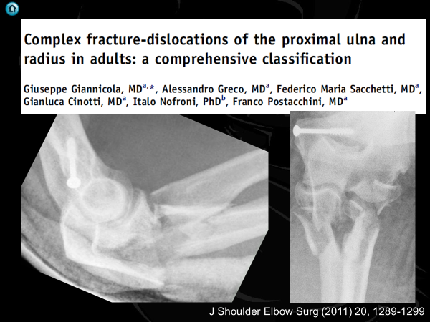

Slide 20
Giannicola 2011
J Shoulder Elbow Surg (2011) 20, 1289-1299

Slide 21
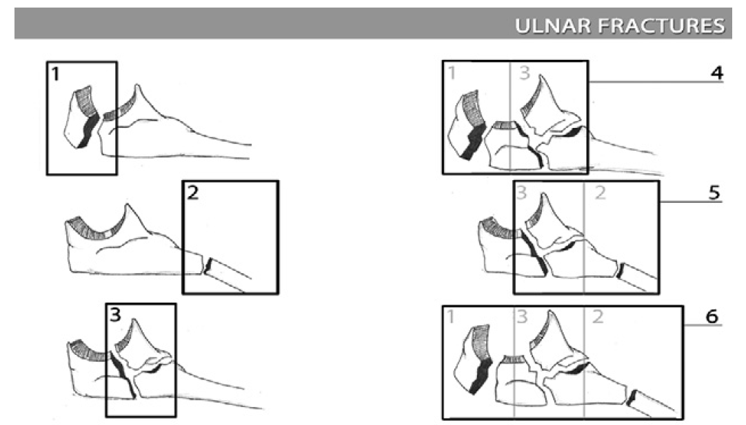
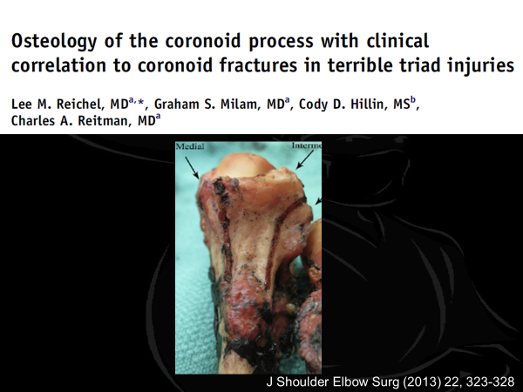
Giannicola 2011
J Shoulder Elbow Surg (2011) 20, 1289-1299

Slide 22

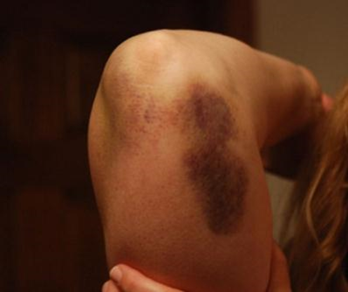
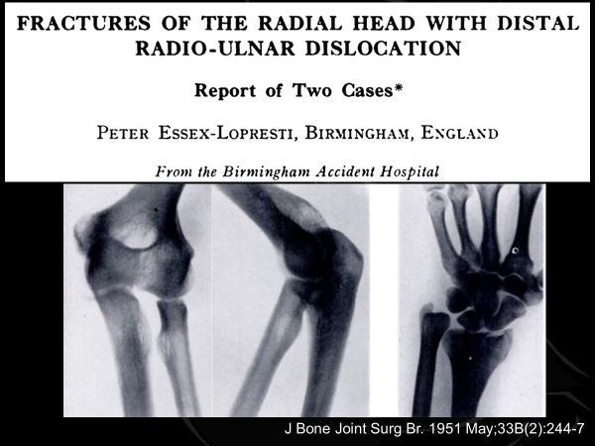
Radial head
Classification
Mason – Mayo (2008)
Adaption of Mason
    Includes suffix to denote associated
      Articular injury
        c = coronoid
        o = olecranon
      Ligamentous injury
        l = lateral collateral ligament
        m = medial collateral ligament
        d = distal radioulnar joint
van Riet RP, Morrey BF.; Clin Orth Relat Res. 2008 Jan;466(1):130-4.

Slide 23
Fix

Slide 24
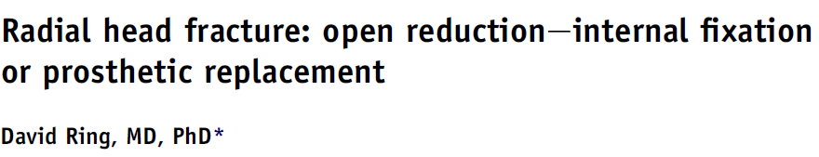
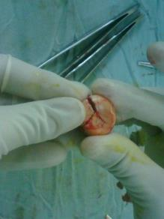

3 pieces generally reconstructable
  If see 2 generally 3 if see 3 then is 4
On table reconstruction of radial head
  Acceptable
Ring more likely to replace
  If Replace don’t overstuff
JSES (2011) 20, S107-S112

Slide 25
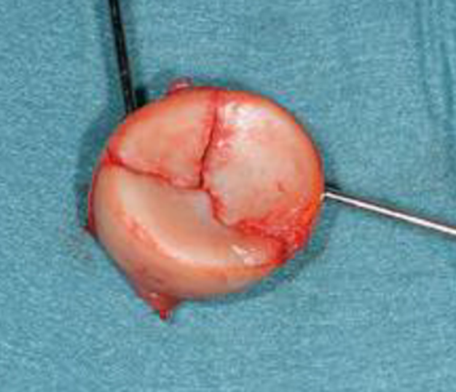
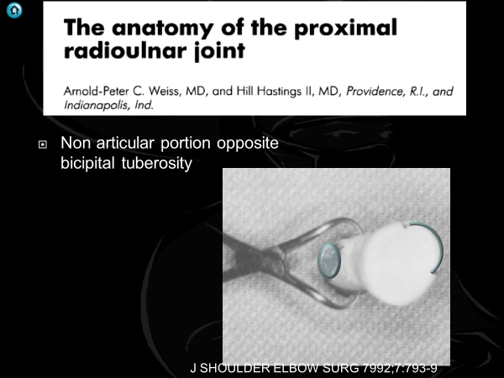

Slide 26
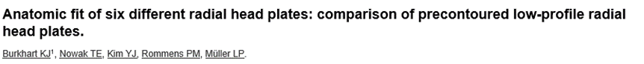
None perfect
Bulky under annular ligament
J Hand Surg Am. 2011 Apr;36(4):617-24

Slide 27
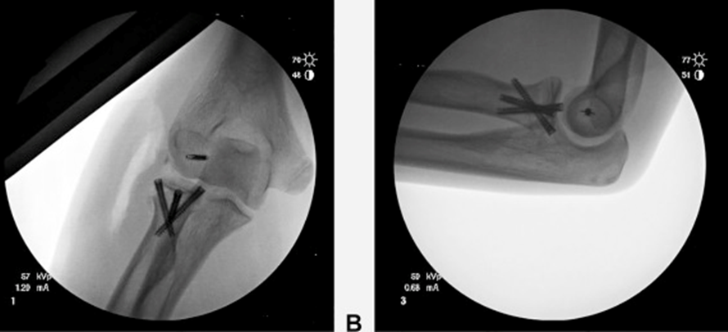

J Orthop Surg (Hong Kong). 2017 May-Aug;25(2)
J Hand Surg Am. 2018 Jun;43(6):575

Slide 28
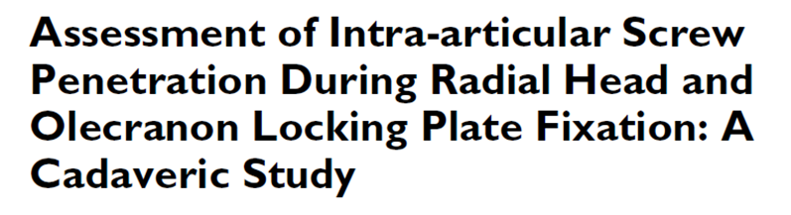
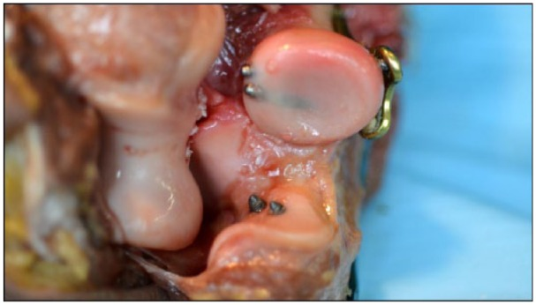
Three fluoroscopic views
  Direct lateral
  Hypersupinated oblique
  Fully pronated lateral
Sensitivity for radial head
  Crepitus 81%
  Radiographs 73%
Hand (N Y). 2016 Mar;11(1):65-71

Slide 29
All
Complex
Coronoid involved
Fix 57%
Replace 38%
Excision 5%
Fix 33%
Replace 64%
Excision
J Hand Surg Am. 2018 Mar;43(3):241-247

Slide 30
Revision
Fix
  1 year = 13%
  2 year = 14%
Replace
  1 year = 9%
  2 year = 11%
Excision
  1 year = 8%
  2 year = 8%
J Hand Surg Am. 2018 Mar;43(3):241-247

Slide 31
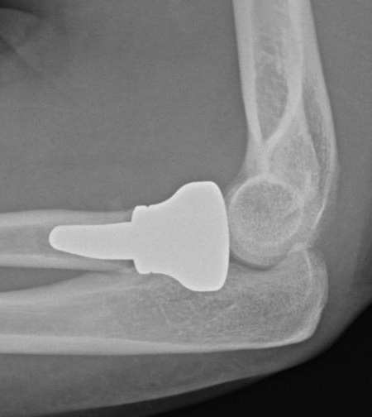
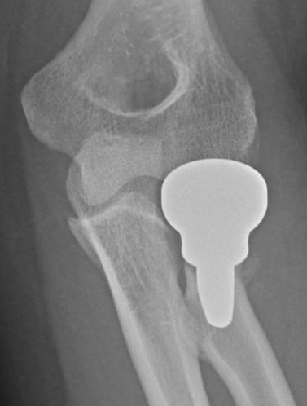
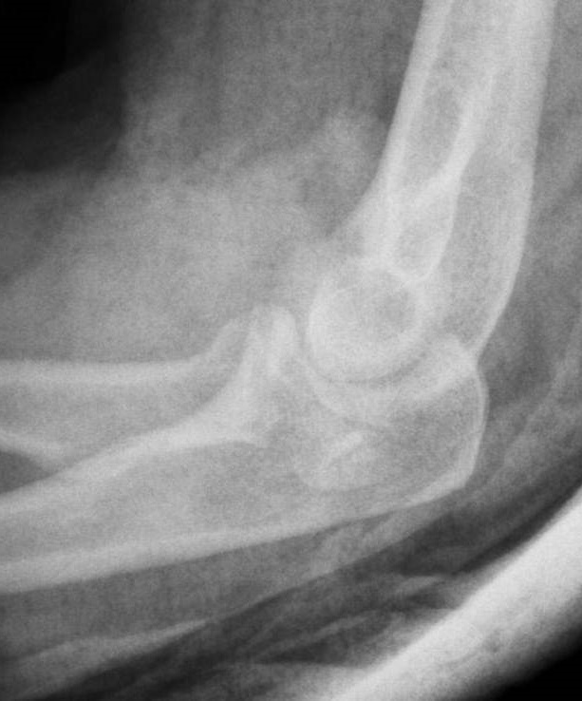
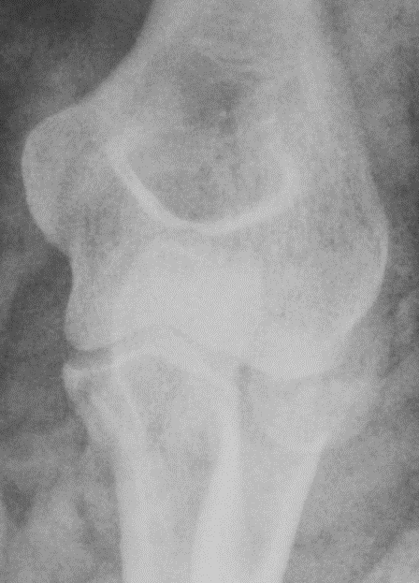
45 YO manual worker

Slide 32
Replace
Hotchkiss (1997)
Adaption of Mason
    1.Undisplaced or minimally displaced (<2mm)
    2. Displaced but amenable to internal fixation
    3.Fracture not amenable to internal fixation
    Excise (80% Grade 3 have ligamentous injury)
    Replace

Slide 33
Replacement
Which radial head

Slide 34

Meta-analysis
  30 studies
1017 patients
  77 Removed
  45 Revised
10% rate removal or revision
  Mean 38 months
Lowest
  Cemented fixation
  Longer stem
  Vitalium stem
  Bipolar prosthesis
J Hand Surg Am. 2018 Jan;43(1):39-53

Slide 35
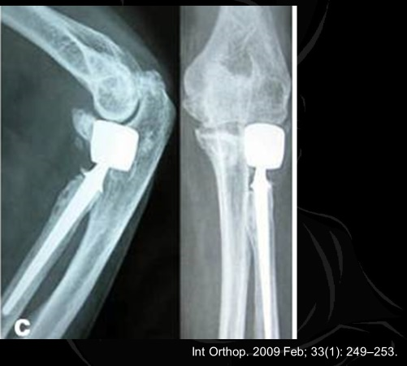
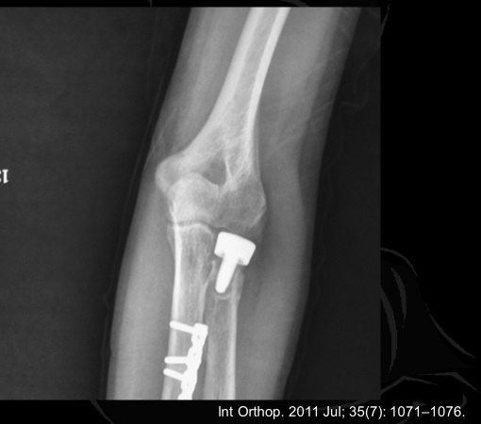
Lowest Revision rates!!

Slide 36

30 articles (1940 – 2015)
727 patients
Revision rate 0 – 29%
Combined excellent results 85%
No evidence 1 implant over another
  Proviso
  Sillicone biomechanically and biologically inferior
JBJS Rev. 2016 Oct 18;4(10).

Slide 37
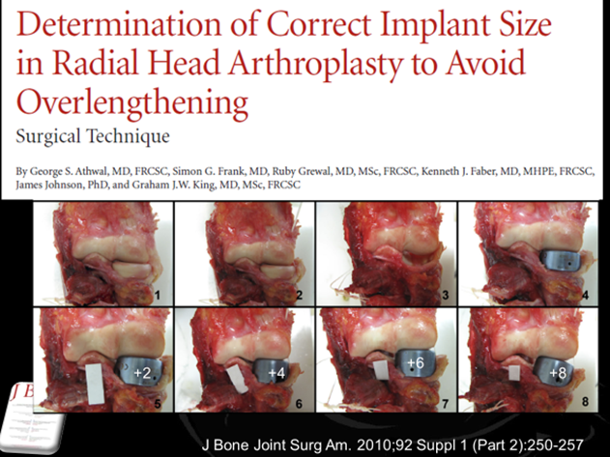
45 YO manual worker

Slide 38
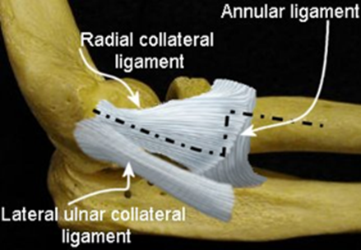
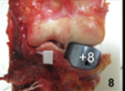
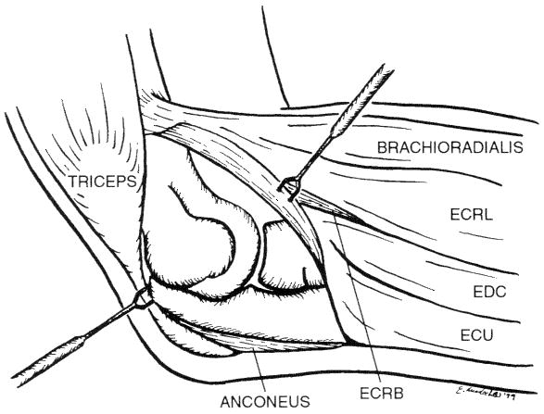
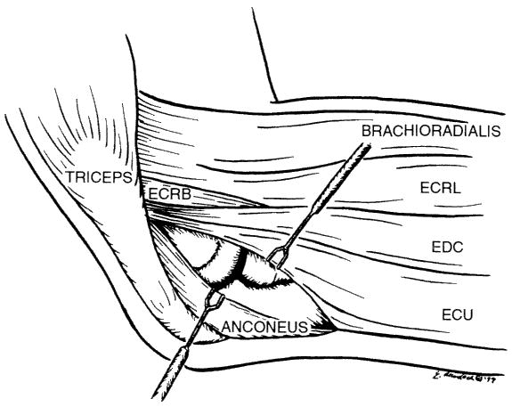
Kocher
Posterolateral
Clin ortho and related research; (370), January 2000, pp 19-33;

Slide 39
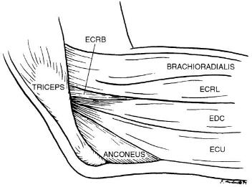

Lateral intervals
Kocher
    between anconeus and ECU
Kaplan
    between ERCB and EDC
EDC Split
Clin ortho and related research; (370), January 2000, pp 19-33

Slide 40
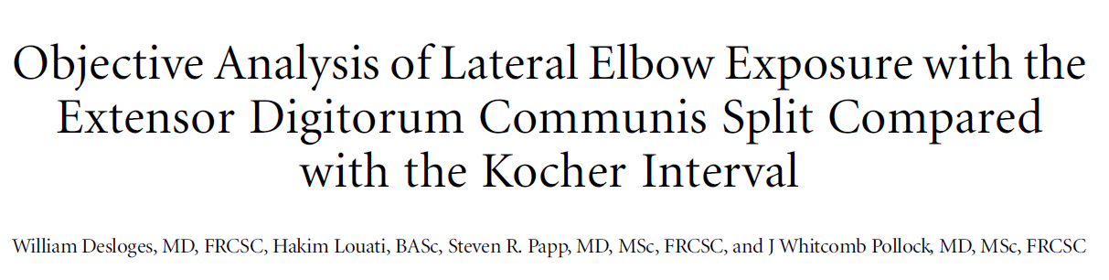
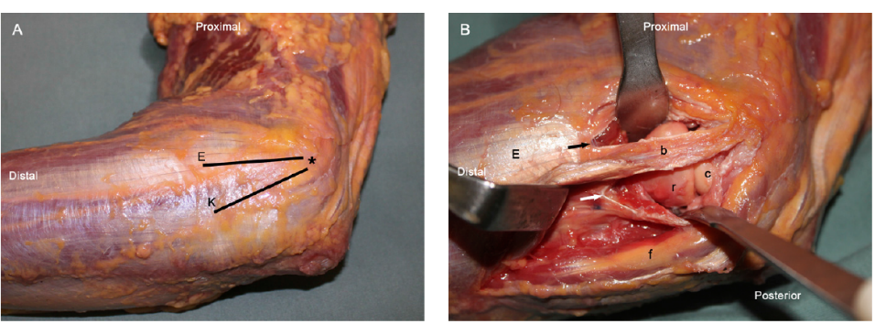
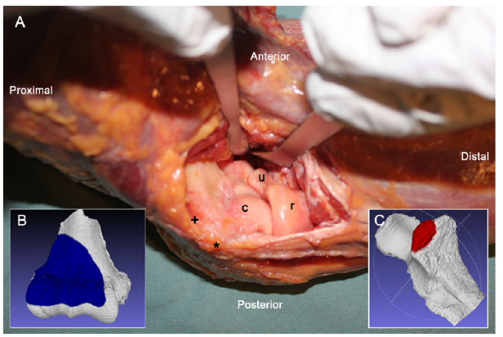
J Bone Joint Surg Am. 2014;96:387-93

Slide 41

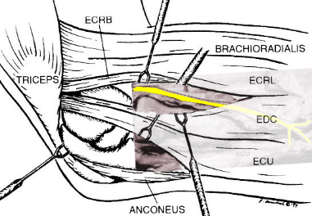
Lateral intervals
Kocher
  LUCL
  Lateral facet Coronoid
Kaplan
EDC Split
  PIN
Clin ortho and related research; (370), January 2000, pp 19-33

Slide 42
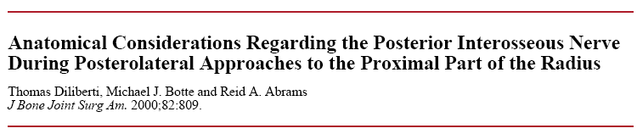




Supination
Pronation
Supination
Pronation
Diliberti T. et.al. J Bone Joint Surg 2000:82:809-809

Slide 43
From Capitellar surface, crosses mid axis
Full supination
Ave. 33.4 ± 5.7 mm
Range 22 – 47 mm
Full pronation
Ave. 52.0 ± 7.8 mm
Range 38 – 68 mm
Diliberti T. et.al. J Bone Joint Surg 2000:82:809-809

Slide 44
Minimum distance from PIN to RCJ
  Supination 4.0 cm
  Pronation 4.3 cm
J Shoulder Elbow Surg 2007;16:502-507

Slide 45


21 YO F

Slide 46


J Bone Joint Surg Br September 2006 88-B: 1178-1182

Slide 47


Boyd interval
Surg. , Gynec. and Obstet,, 71: 87-88, 1940

Slide 48






Boyd interval
Humerus
Ulna
Anconeus

Slide 49










Benefits

Slide 50





+6
+2
+4
J Bone Joint Surg Am. 2010;92 Suppl 1 (Part 2):250-257

Slide 51




Avoid understuffing
  X ray 2mm proud neutral forearm
  Supination longer, pronation shorter
Perfect

Slide 52




Overstuffed ?

Slide 53

Excision

Slide 54

29 Papers
  Most radial head last 10 years
  Excision very little last 20 years
Radial head replacement
  Good outcome
    Range of motion
    Pain
    Stability
Excision acceptable
    Isolated radial head no ligament injury
    Good durable outcomes
Biomed Res Int. 2018 Jul 16;2018

Slide 55
Radial head
Classification
Hotchkiss (1997)
Adaption of Mason
    1. Undisplaced or minimally displaced (<2mm)
    2. Displaced but amenable to internal fixation
    3. Fracture not amenable to internal fixation

Slide 56




Slide 57





Delayed
Arthroscopic
International Orthopaedics (SICOT) (2012) 36:2507–2512

Slide 58
Thank You www.cambridgeses.co.uk

Slide 59
Overstuffed ?

Slide 60

Int Orthop. 2009 Feb; 33(1): 249–253.

Slide 61
Replace
Hotchkiss (1997)
Adaption of Mason
    1.Undisplaced or minimally displaced (<2mm)
    2. Displaced but amenable to internal fixation
    3.Fracture not amenable to internal fixation
    Excise (80% Grade 3 have ligamentous injury)
    Replace

Slide 62


Long stem

Slide 63








25 YO
Farmer
1 year

Slide 64

Int J Surg Case Rep. 2015; 15: 35–38.

Slide 65


Revise

Slide 66
Revise

Slide 67
Int Orthop. 2011 Jul; 35(7): 1071–1076.

Slide 68




